Slide 1
DATA STRUCTURES AND ALGORITHM - 2
TEAM-13

Slide 2
TEAM MEMBERS
NAME |  | ROLL NO
KARTHIKEYAN M |  | CB.EN.U4AIE20028
KARTHIK RAJA B |  | CB.EN.U4AIE20027
NALIN M R |  | CB.EN.U4AIE20041
PRAGADISHWARAN K |  | CB.EN.U4AIE20051
RISHEKESAN S V |  | CB.EN.U4AIE20058

Slide 3
Contents
01
02
03
04
Kruskal Algorithm
Prim's Algorithm
Clustering using Prim's and Kruskal
Implementation in Java and Python

Slide 4
01
CLUSTERING USING KRUSKAL'S AND PRIM'S ALGORITHM

Slide 5
Spanning Tree
Spanning tree - A spanning tree is the subgraph of an undirected
Connected graph.
Minimum Spanning tree - Minimum spanning tree can be
defined as the spanning tree in which the sum of the
weights of the edge is minimum. The weight of the
spanning tree is the sum of the weights given to the edges
of spanning tree.
In case of spanning tree it should it be a connected graph,
undirected and it never contains cycle.

Slide 6
Kruskal's Algorithm
Kruskal's Algorithm is used to find the minimum spanning tree for a connected weighted graph. The main target of the algorithm is to find the subset of edges by using which we can traverse every vertex of the graph. It follows the greedy approach that finds an optimum solution at every stage instead of focusing on a global optimum
The algorithm that takes a graph as input and finds the subset of the edges of that graph which
1. Form a tree that includes every vertex
2. Has the minimum sum of weights among all the trees that can be formed from the graph

Slide 7
Kruskal's algorithm steps:
In Kruskal's algorithm, we start from edges with the lowest weight and keep adding the edges until the goal is reached.
The steps to implement Kruskal's algorithm are listed as follows -
First, sort all the edges from low weight to high.
Now, take the edge with the lowest weight and add it to the spanning tree. If the edge to be added creates a cycle, then reject the edge.
Continue to add the edges until we reach all vertices, and a minimum spanning tree is created.

Slide 8
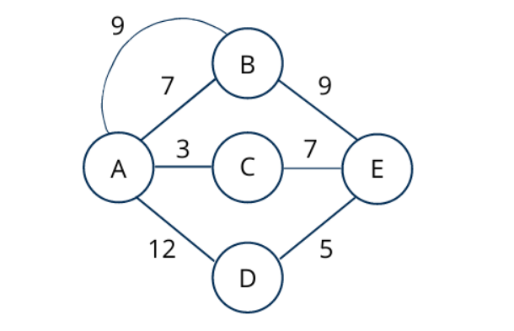
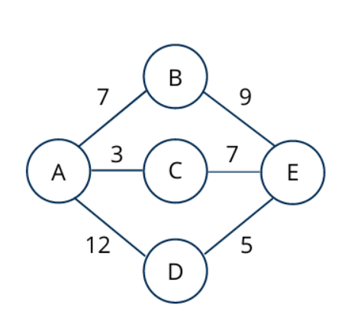
Let us consider the below-weighted graph

Slide 9
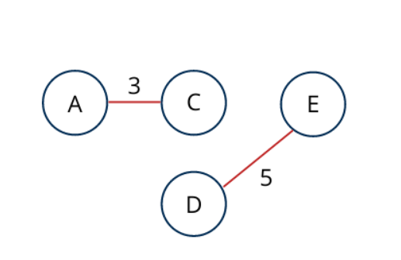
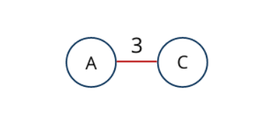
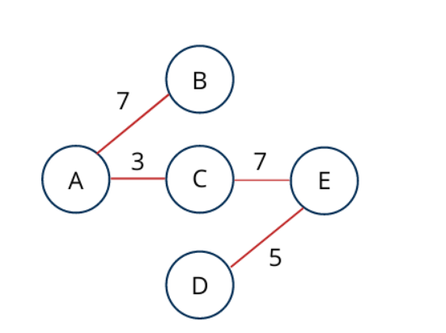

Slide 10
Prim’s Algorithm
Prim's Algorithm is a greedy algorithm that is used to find the minimum spanning tree from a graph. Prim's algorithm finds the subset of edges that includes every vertex of the graph such that the sum of the weights of the edges can be minimized.
Prim's algorithm starts with the single node and explores all the adjacent nodes with all the connecting edges at every step. The edges with the minimal weights causing no cycles in the graph got selected.
It is used for finding the Minimum Spanning Tree (MST) of a given graph and graph must be weighted, connected and undirected.

Slide 11
Step 2
Step 1
Find all the edges that connect the tree to new vertices.
Find the least weight edge among those edges and include it in the existing tree.
If including that edge creates a cycle, then reject that edge and look for the next least weight edge
Randomly choose any vertex.
The vertex connecting to the edge having least weight is usually selected.
Step 3
Keep repeating step-02 until all the vertices are included and Minimum Spanning Tree (MST) is obtained.

Slide 12
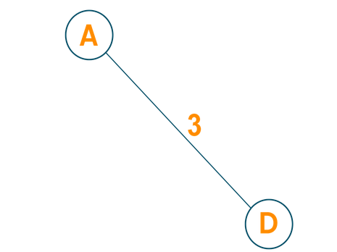
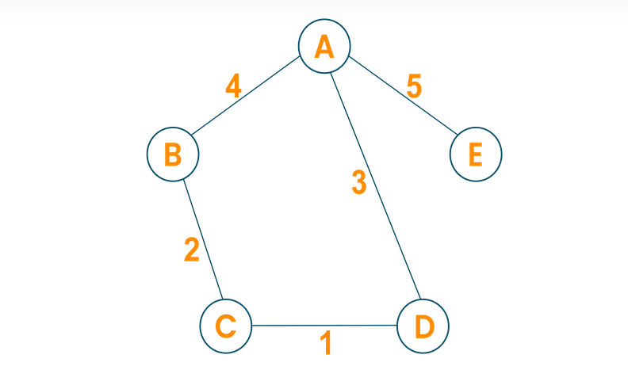

Let us consider the below-weighted graph

Slide 13
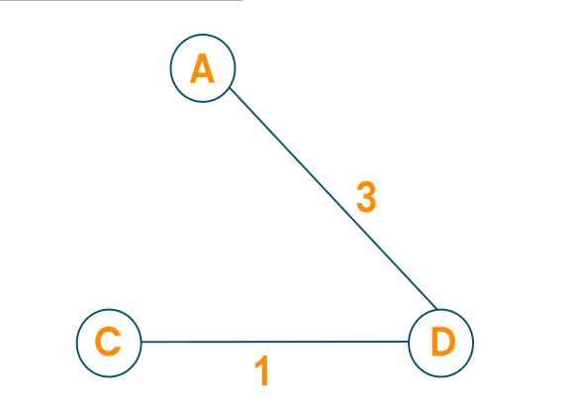
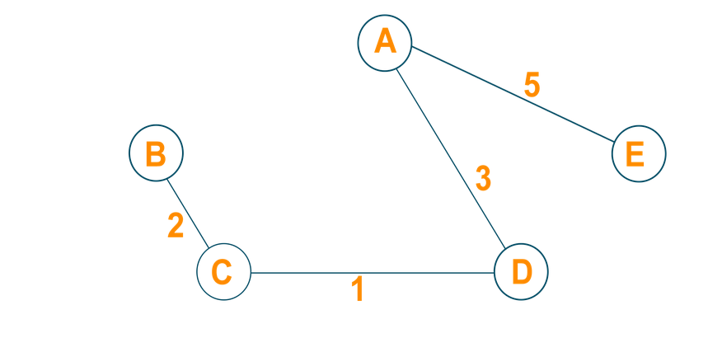

Slide 14
Overview of Clustering
Clustering is the task of dividing the population or data points into a number of groups such that data points in the same groups are more similar to other data points in the same group than those in other groups. In simple words, the aim is to segregate groups with similar traits and assign them into clusters.
Clustering has a large no. of applications spread across various domains. Some of the most popular applications of clustering are:
Recommendation engines
Market segmentation
Social network analysis
Search result grouping

Slide 15
Clustering using Prim's and Kruskal's algorithm

Slide 16
Union -Find Data Structures
A union–find data structure or merge–find set, is a data structure that stores a collection of disjoint (non-overlapping) sets.
To work efficiently Kruskal’s algorithm requires a data structure to store the collection of connected components of a graph and merge then when necessary
More precisely, the data structure has to support the following operations:
find (x) : returns a label to which set x belongs
make_set : function that sets the value of a given vertex to “None” in the dictionary “parent” (it creates a singleton)
union(x, y) : merge the sets containing x and y

Slide 17
Kruskal’s Algorithm with Union-Find
To avoid searching for an edge of minimum weight, sort the edges in the beginning of the algorithm
If T is the current set of selected edges, the data structure contains the collection of connected components of
To check whether edge (v,w) forms a cycle just check if find(v) = find (w)
Follow the sorted list of edges. Every time for edge (v,w) if it forms a cycle, remove it from the list. If it does not, merge the sets containing v and w, and remove the edge from the list .

Slide 18
Priority Queue And Heap
A priority queue is a data structure that supports insertion and delete- maximum operations (the latter removes the maximum element from the queue). Sometimes we also want to allow an update operation that changes the value of an element in the queue or a delete operation.
A heap is a binary tree such that each node is greater than or equal to its children. (A min-heap would be just the opposite). It is also a balanced binary tree, so the leaves are all on the last one or two levels of the tree.

Slide 19
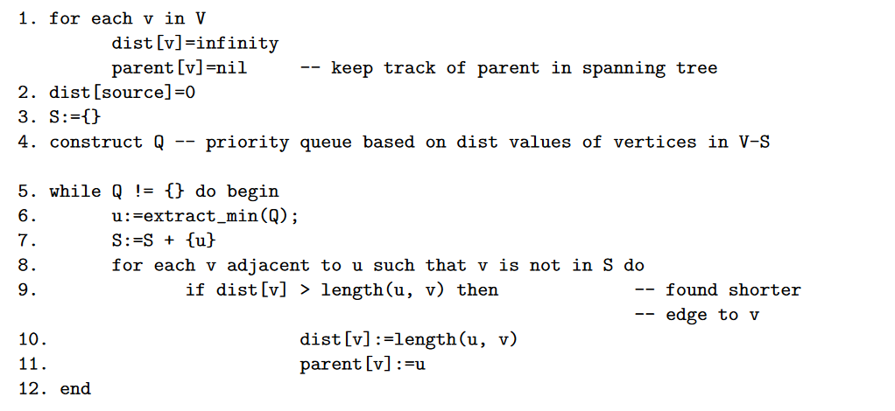
Prim's Algorithm implementation
Prim’s MST Algorithm uses a distance function to specify the closeness of data objects to establish the weight between them by choosing an arbitrary point to the next adjacent point of minimum weight.
For clustering, an edge inconsistency measure is defined to identify an inconsistent edge to be removed to partition the whole dataset into clusters

Slide 20
IMPLEMENTATION

Slide 21
THANK YOU

